Slide 1
Mobile Application Testing

Slide 2
TOPICS
Mobile Application
Types of mobile application
Web designs
Mobile Software Development cycle
Mobile specific testing
Emulator and Simulator
Adb commands

Slide 3
Mobile Application
The term mobile application refers to self contained program that are designed to execute on Mobile Devices.
It refers to Application that can be installed in Mobile and run the app.
Types of Mobile Applications
Native Apps
Web Apps
Hybrid Apps
Cross Platform Apps
PWA – Progressive Web Application

Slide 4
Native Application
Native Apps are the applications which is developed using single programming language for specific platform using their own IDE
Specifically Developed for one platform.
Examples- Calendar, Message, Phone, Contacts, Calculator etc.
Disadvantages:
Development cost is high .
Code is not reusable
More time is required for developing specific version and release also.
Advantages:
Fast and Responsive
Rich user experience
Works offline
Access to full features set of devices.

Slide 5
Web Application
These are the applications which we can access by entering URL in your Mobile Browsers.
Web apps are the application which is developed using technologies like HTML5, CSS3 and JavaScript.
Examples
YouTube.com- m.youtube.com
facebook.com – m.facebook.com
Advantages
Development cost is less .
It is easy and faster to develop
No need of installing the application
It can be accessed just by entering the URL in your Mobile Browser
Disadvantages
Cannot use offline.
Very less access to device hardware features like Camera, GPS and sensors

Slide 6
Hybrid Application
combination of native App and web App.
90% is developed by web and 10% by native
Web technology – HTML, CSS3, JavaScript where these contents can be reused but they need to develop only on native contents.
Example- Instagram, Facebook etc.
Advantages:
Development cost is less
Code Reusage.
Access is easy.
Disadvantages:
Performance is slow
Requires internet connection

Slide 7
Cross Platform Application
These applications are developed using single programming language for different platforms
Developed using Java Script, C#, Dart etc.
developing one application which can run over different platforms like iOS , Android, Windows
Advantages:
Cost Reducibility
Cost – Effectiveness
Shorter Time to Market
Disadvantages:
Security
User Experience

Slide 8
PWA – Progressive Web Application
Developed by Google.
Only for Android and Windows devices.
Can be used only in Google Chrome.
takes very less storage.

Slide 9
WEB DESIGNS
It is the process of Optimizing the Web experience for mobile users.
There are four types of web designs
Adaptive
Liquid
Static
Responsive
1. Adaptive:
Adaptive is characterized by having defined layouts for different resolutions. Within each layout, resizing the window does not change the layout
2. Liquid:
Liquid (also called "Fluid") is characterized by scaling the width of parts of the design relative to the window. It tends to fail when the window is much smaller or much larger than it was originally designed for.

Slide 10
3. Static:
Static layouts are the traditional web: one design that sits in the center of the page and requires horizontal scrolling if the window is too small for it.
4. Responsive:
Responsive is characterized by having defined layouts for different resolutions. Within each layout, the design is liquid and resizes the width of elements relative to the changing window size.
MSDLC – MOBILE SOFTWARE DEVELOPMENT CYCLE
The lifecycle of mobile development is largely no different than the SDLC for web desktop applications. It has five major portions of the process namely:
Inception – Requirement / System Analysis
Design – UX and UI
Development – Coding / UI Coding
Stabilization – Testing
Deployment/ Distribution/ Maintenance

Slide 11
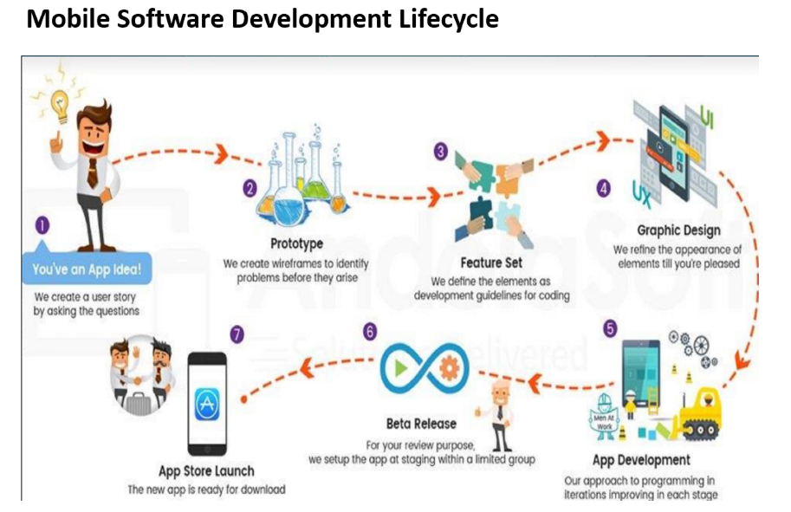

Slide 12
Requirement Analysis / Inception Phase
All the applications start with an idea. This idea is usually refined into a solid requirement for an application.
A team is involved with BA + IT and some considerations are made We analyze the following:
1.Competitive advantage:
Are there similar apps out there? If so, how does this application differentiate from others?
What Users wants in the market?
What extra feature we can develop?
2. Infrastructure Integration: What existing infrastructures will it integrate with or extend?
3. Value: What value does this app bring users? How will they use it?
4. Form / Mobility: How will this app work in a mobile form factor? How can I add value using mobile technologies such as location awareness, the camera, etc.

Slide 13
Design Phase
Once we have a good idea of what it is we want to design, the next step is to start trying to solve the User Experience or UX.
The design phase concentrates on the software architecture of the application.
The core functionalities are identified and are broke down in to different modules. Later integration of these modules is also defined.
The UX and UI designs are created.
User Experience [UX] Design
User Interface [UI] Design
Development Phase
In this phase application is coded. Development process can be in stages.
1.Coding for functionality requirement
2.Coding for UI requirements
Firstly the core functions are coded and parallel development can be done for multiple modules and then modules are integrated.

Slide 14
Development Phase
In this phase application is coded. Development process can be in stages.
1.Coding for functionality requirement
2.Coding for UI requirements
Firstly the core functions are coded and parallel development can be done for multiple modules and then modules are integrated.
Prototyping:
The application is in proof of concept and only core functionality or specific parts are working
The prototypes are tested and sent to the client for feedback and the feedback changes are implemented
The development, prototyping and testing the prototypes are repeated until final protocol is ready.

Slide 15
Stabilization Phase [Testing]
Stabilization is the process of working out the bugs in the application.
Typically, applications go into Prototype, Alpha, Beta, and Release Candidate / Production stages.
Prototype
Alpha
Beta
Release Candidate / Production
Distribution / Deployment Phase
The final stage of development process after final feedback is obtained from feedback is obtained from client, the application is ready for deployment.
Maintenance:
Maintenance is continuous process
Feedback is collected from users and made in form of bug fixes or improvement.

Slide 16
Mobile Specific Testing
The types of mobile specific testing are:
Installation Testing
Stand By Testing
Interruption Testing
Orientation Testing
UI Testing
Gesture Testing
Compatibility Testing
Cross Platform Testing
Geo Location Testing
Network Testing

Slide 17
Installation Testing:
Installation Testing is the process to verify whether the application installation goes smoothly without any errors.
Installation Testing is further classified into three phases namely
Installation
Update
Uninstall.
Stand By Testing:
In this phase we verify the application UI by putting the device in a standby mode (Which means) minimizing the application or locking the screen etc.. for different durations.
Once we wake up the device the application should continue from the same point where it was put on standby mode.
Interruption Testing:
Process where user purposefully disturbs the application and checks the application stability by interrupting with other applications and hardware devices.

Slide 18
Orientation Testing:
Testing the different orientations like Portrait and landscape. Verify the UI of the application by changing the screen from Portrait to landscape and vice versa.
Gesture Testing:
Verifying the application UI by performing the following actions
Swipe Horizontal
Swipe Vertical
Tap
Pinch out [zoom in]
Pinch in [zoom out]
Double tap etc.
Compatibility Testing:
Verify the application indifferent devices, OS, versions, RAM size, SoC, battery capacity, screen density, screen size and check whether the application is compactable or not.

Slide 19
Cross platform Testing:
Cross checking the application on different platforms [ ie., iOS and Android ]
Network Testing:
Test the application on different network speed like 4G, 2G, 3G, Wifi etc.
UI Testing:
Verify whether all UI elements like radio buttons, checkbox, drop down menu etc. are working properly and also the graphical elements of the application is checked.
Emulator and Simulator
Emulator and Simulator help us to run the mobile OS on our desktop.
Before installing the application the developer use Emulator and Simulator to check whether the application is working properly or not.
Emulator and Simulator provides us the same usage experience like mobile phones.
We can do the following actions:
Install
Change network
Change battery levels
Roaming network
SIM card simulation

Slide 20
Emulator:
Is an application that emulates real mobile device software, hardware and OS which allows the testers and developers to debug and test.
As the emulator includes RAM, Processor, Battery performance it affects the performance of the software.
Simulator:
Simulator is the software that imitates the working of the software on your system that was made for the particular mobile device.
Simulators does not include hardware like RAM or Battery

Slide 21
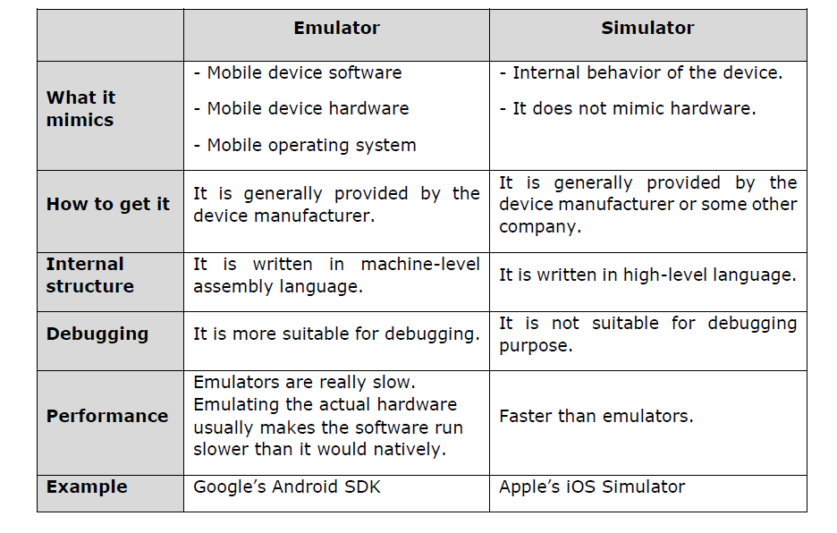

Slide 22
ADB COMMANDS
Android Debug Bridge- works only for Android not for iOS.
ADB commands use to Install app, Push /pull files, Screen capture, screen Record and to take logs
Works on the TCP port Number 5034
It has 3 Components
1.Client
2.ADB server
3.Demon
It is Command User Interface where we work based on the commands.
ADB manages the communication between client and device.
Client-runs the command
Server-Manages the command between client and demon
Demon-Executes the command in the Devices.

Slide 23
Client and Server need to configure in system
Daemon Configuration needs to be done in Device
1.adb start-server
2.adb kill-server
3.adb devices
4.adb install <path of the apk>
eg: adb install D:\abc.apk
5.adb uninstall <package name>
eg: adb uninstall com.abc.android
to see packages list
6.adb shell pm list packages
multiple devices command
7.adb -s <device name/serial no> uninstall <package name>
eg: adb -s 27d0e054 uninstall com.abc.andriod

Slide 24
8.adb -s <device name/serial no> install <path of the apk>
eg: adb -s 27d0e054 install D:\abc.apk
9.adb connect <ip address>
eg: adb connect 192.168.0.129:5555
10.adb disconnect
push->pc to mobile
pull ->mobile to pc
11. adb push <pc path/from path> /sdcard(mobile path)
eg: adb push C:\abc.apk /sdcard
12. adb pull /sdcard(mobile path) <pc path/to path>

Slide 25
THANK YOU

